Slide 1
Flex UI Architecture
By Andriy.Huang, to 2012-03-15

Slide 2
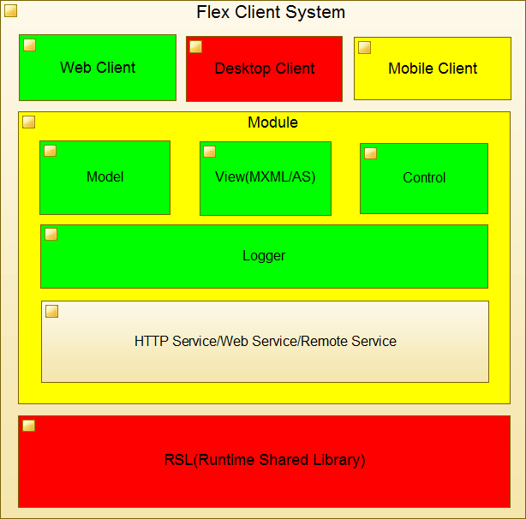

Slide 3
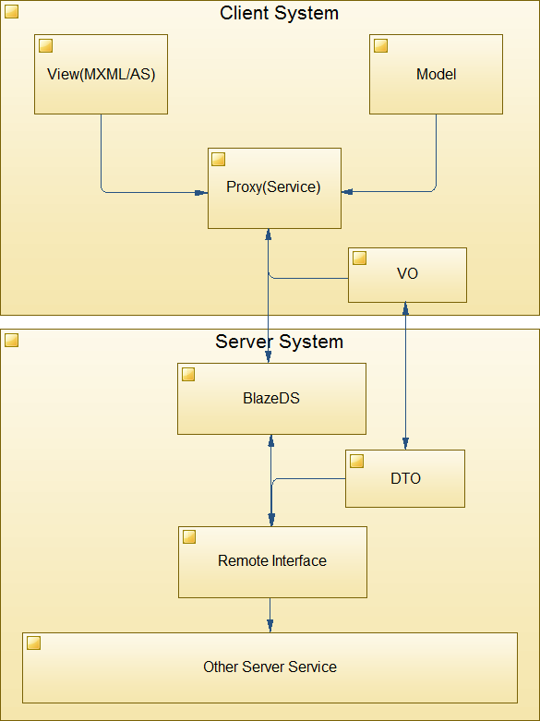

Slide 4
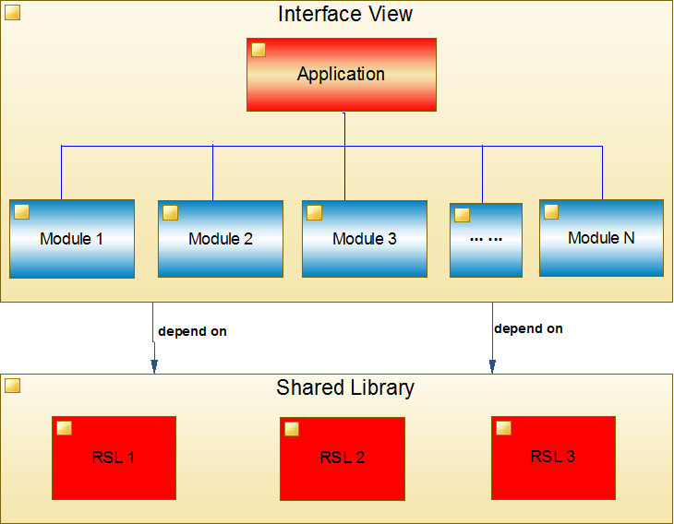

Slide 5
Thanks!

